Slide 1
Sentimental LIAR: Extended Corpus and Deep Learning Models for Fake Claim Classification
Presented By - MD.SHAJIB HOSSAIN
Student ID - 19101250

Slide 2
INTRODUCTION
The Rapid Integration of social media to our daily lives
Ease of access to information and news
To automate of the classification task of fake claim in short text

Slide 3

Motivation and Purpose of This Research Paper
To Classify Fake Claim Represented Using Short Text
To automate the process of Fake Claim Classification
To Use Deep learning Approach To
To Cope Up With the Rapid Velocity of flow of Information on Social media

Slide 4
Methodology And Dataset
Open Source Datasets that has been used by the authors of this research paper are listed Below :
FEVER: Fact Extraction and VERification (FEVER) is a short claim dataset of 185,445 claims. This dataset is annotated with three labels: Supported, Refuted, and Not Enough Info. The claims are curated from Wikipedia. FEVER was constructed in two stages
2) PHEME : Is a dataset of 330 rumor threads composed of 4843 tweets associated with 9 newsworthy events. The annotators of this dataset were journalists who tracked the events in real time. Each entry in PHEME is labeled as either true or false
3) LIAR : is a publicly available short statement dataset that is derived from Politifact.com. Each of the 12,836 statements in LIAR is annotated based on data available on Politifact with one of the following six labels: pants-fire, false, barely true, half-true, mostly-true, and true. The dataset contains the text of a claim, as well as relevant meta-data,

Slide 5
Methodology And Dataset
The authors Have Proposed Deep Neural Network Models
For this research the authors have splitted the dataset as 80% for traninng purpose and rest for the testing purposes.
Have Used BERT model which is of the most finest models in the fields of NLP
BERT: Bidirectional Encoder Representations from Transformer (BERT) [19] is a state of the art word representation model that uses a transformer to learn the contextual relationships between the given text in a bidirectional manner (i.e., in both left-to-right and right-to-left). The bidirectionality of BERT has made it stand out in many NLP tasks, as it improves fine tuning based approaches to token level tasks.

Slide 6
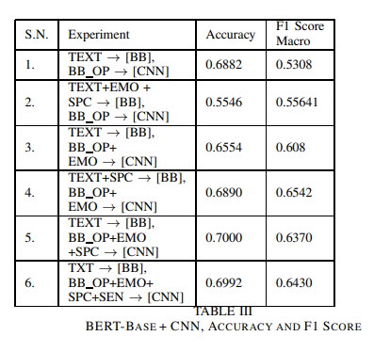
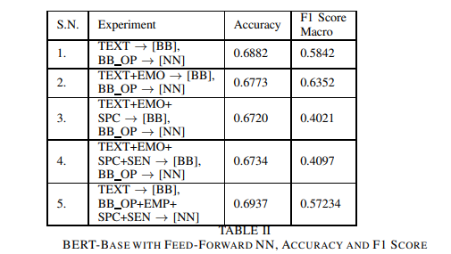
Result and Analysis

Slide 7
Limitations and Future Work
Low accuracy
Not enough data to train the model

